Slide 1
Human Attention Modeling with Co-Adaptive Computer Interface (tentative)
Sabin Park
3 October 2016

Slide 2
Progress
Redirection on research focus
Reading on user interface and modeling
New ideas on user modeling research

Slide 3


Background
Monitoring of human user and adapting system to user needs
Two Contexts:
Simple monitoring function (input-output system)
Provide better situational awareness to user (adaptive system)
Significance:
Increase user task-effectiveness in a wide scope of applications by providing an adaptive user interface depending on the user and the user’s specific needs
Human System
Semi-Autonomous System
Autonomous System

Slide 4
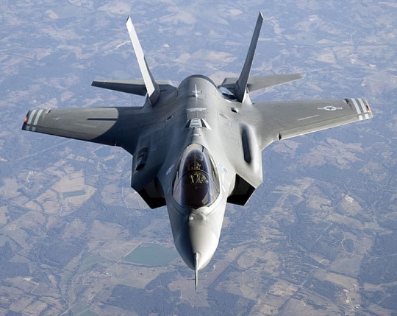
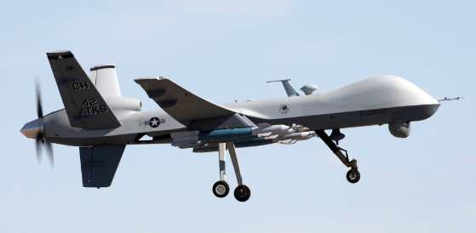
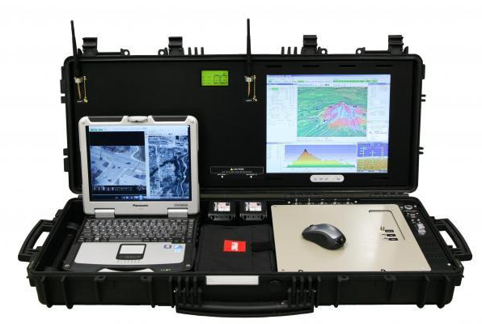
Applications
Train crash prevention (critical points = rail changing intersections)
Drone operators (multi-tasking while maintaining mission effectiveness)
User’s ability to learn new, complex software

Slide 5
Models
Behavior model
Derived from sensors that analyze user’s behavior
Attention model
Uses the user’s behavior and models the level of user attention
Task/Context model
Models the environment around the user and the associated tasks

Slide 6
Semester Project and Research Plan
Derive a behavior model in a simplified multi-tasking context
Design a program that provides a multi-tasking scenario analogous to the F-35/drone situation
Keep track of user actions taken in the environment
Ie) Different patterns of behavior allows system to adapt to user and automatically change the user interface
Ie) Recognize user input patterns in a system and adapt system for optimal performance
Look into different modalities; not necessarily limited to computer vision
VR/AR
Wearable controllable devices
2D graphical display
Continue literature review and lab discussions with Draper

Slide 7
feedback
Research plan timeline
More specific
“Progress overview page”
Past week
This week
Next week

Slide 8
Background
Monitoring of human user and gaining user attention when certain conditions require human intervention
Two Contexts:
Simple monitoring function (input-output system)
Provide better situational awareness to user (adaptive system)
Significance:
Increase user task-effectiveness in a wide scope of applications by providing an adaptive user interface depending on the user and the user’s specific needs
Human System
Semi-Autonomous System
Autonomous System

